Slide 1

ADITYA ENGINEERING COLLEGE(A)
SMART HELMET ENFORCEMENT SYSTEM USING DEEP LEARNING AND IOT
Batch No : A1
UNDER THE GUIDANCE OF
Dr. S. Rama Sree.,Ph.D Professor &
Dean (Academics)
Computer Science and Engineering
Aditya Engineering College (A)
PRESENTED BY:
Pula Vaishnavi (20A91A0552)
Namala Aakash (20A91A0544)
Karumanchi Hemanth (20A91A0526)
Thirupathi Krishna Maheedhar (20A91A0559)

Slide 2
CONTENTS
Abstract
Introduction
Problem statement
Aim & Objective of the project
Existing System and Disadvantages
Proposed system and Advantages
Literature Survey Comparison Table
Requirement Analysis(SRS/HRS)
Project Flow
Technology/Algorithm Used
Modules
Detailed Design
UML Diagrams
Testing and Test cases
Results/Screens
Conclusion and scope for future work
References

Slide 3
ABSTRACT
Safety is paramount in transportation, particularly when riding motorcycles, where accidents can have severe consequences.
Wearing a helmet is crucial for preventing head injuries and protecting the brain during crashes.
To promote helmet usage and enhance safety, a proposed model utilizes IoT and Deep Learning, specifically the You Only Look Once (YOLO) technique, to detect helmet usage among riders.
Developed using Python programming language, this model aims to reduce accidents by encouraging helmet-wearing behavior among drivers, contributing to a culture of safe motorcycle riding and preventing traumatic brain injuries in the long term.

Slide 4
INTRODUCTION
Deep learning is a branch of machine learning and artificial intelligence (AI) that imitates the way of humans in gaining certain types of knowledge.
You Only Look Once (YOLO) is a structured Convolutional Neural Networks (CNN) model used in deep learning which is mostly applied to images and videos for their analysis.
In our proposed model,
YOLO is used for recognizing the driver’s wearing a helmet and also with absence of helmet.
Image datasets of both wearing a helmet and not wearing is trained rigorously to the model.
The model uses camera feed to process the driver images randomly in order to produce the result whether he/she is wearing a helmet or not.
The model is trained with an algorithm which enables it to classify images of various categories.

Slide 5
Problem Statement
In many instances, accidents occur due to a lack of proper safety precautions. While cars have seat belt indicators to promote safety, motorcycles primarily rely on helmet usage. Unfortunately, a significant number of riders neglect this crucial safety measure, leading to accidents and substantial losses.
To address this issue, we propose implementing a technology that detects whether a rider is wearing a helmet before allowing the engine to start. A sensor will be installed on the bike's front side, facing the rider, to detect the presence of a helmet. The sensor will provide an output, allowing the bike engine to start only if a helmet is detected.
To prevent riders from removing their helmets once the bike is in motion, we plan to use a small camera to capture the rider's head and helmet. A Machine Learning algorithm, such as a YOLO, Convolutional Neural Network (CNN), will be employed to determine whether the rider is wearing a helmet. If the algorithm detects the absence of a helmet while the bike is in motion, the system will initiate a gradual slowdown until the bike comes to a complete stop.

Slide 6
AIM & OBJECTIVE
Aim:
The main aim of the project is to automate and enforce helmet usage among two-wheeler riders using advanced technology and Deep Learning model.
Objective:
To train an algorithm which enables to classify images of two identified categories.
To improve the safe riding and usage of helmets.
To help the reduction in fatalities, injuries and occurrence of accidents.

Slide 7
LITERATURE SURVEY
S.No | Reference Paper Title | Purpose | Drawbacks
1 | "Automatic Detection of Bike-riders without Helmet using Surveillance Videos in Real-time" | The paper aims to develop an automated system for detecting bike riders without helmets in real-time to enhance road safety. | Potential limitations include reliance on video surveillance, possibility of false positives, sensitivity to environmental conditions, and regulatory compliance challenges.
2 | “Real-time license plate detection for non-helmeted motorcyclists using YOLO.” | To develop a real-time application for detecting license plates of non-helmeted motorcyclists using a single convolutional neural network. | Reliance on license plates located at the rear position, absence of license plates on some motorbikes, and dependence on the LP detection being performed before a centroid crosses a reference line.
3 | “Helmet Detection Using Machine Learning” | To develop a real-time autonomous system for detecting helmet usage among motorcycle riders using the YOLO deep learning method. | Manual strategies for helmet enforcement are inefficient and have drawbacks such as interrupting traffic flow and being dependent on weather conditions..

Slide 8
LITERATURE SURVEY
S.No | Reference Paper Title | Purpose | Drawbacks
4 | “Smart Engine Control System Linked to Helmet Detection Using YOLOv8” | To develop a system integrating deep learning and IoT to detect helmet usage and control engine startup based on helmet presence, aiming to reduce motorcycle accidents and fatalities. | While the system aims to enhance safety, it may face challenges in implementation such as compatibility issues with different motorcycle models and potential false positives or negatives in helmet detection.
5 | “Intelligent Helmet Detection Using OpenCV and Machine Learning” | To develop a system utilizing machine learning and OpenCV for automated detection of helmet usage among motorists, aiming to reduce fatal injuries caused by negligence. | Potential limitations may include the reliance on precise positioning and lighting conditions for accurate helmet detection, as well as challenges in real-world implementation and scalability.
6 | Design & Implementation of IoT Based Smart Helmet for Road Accident Detection | Introduce a smart helmet system using IoT to prevent road accidents by detecting alcohol consumption, ensuring helmet usage, and providing accident detection and notification capabilities. | Lack of detailed discussion on scalability and feasibility of mass production, and limited exploration of real-world implementation challenges.

Slide 9
LITERATURE SURVEY
S.No | Reference Paper Title | Purpose | Drawbacks
7 | "Smart Helmet with Quick Ambulance Response System" | To develop a smart helmet system that enhances rider safety by incorporating features like alcohol detection, accident identification, and quick ambulance response. | Lack of reliability on Raspberry Pi for image processing, high cost associated with improving vehicle detection model.
8 | “Real Time Road Surveillance and Vehicle Detection using Deep Learning” | To enhance road safety in India through real-time surveillance using deep learning, focusing on vehicle detection for enforcing traffic laws like helmet usage and seatbelt enforcement. | Possible limitations include biased training data, hardware requirements, narrow scope, ethical concerns, and integration challenges, which could impact the system's effectiveness and implementation.
9 | “Fine-Tuning YOLOv5 with Genetic Algorithm For Helmet Violation Detection” | Proposes a real-time helmet violation detection system using YOLOv5 and genetic algorithm fine-tuning to enhance motorcycle safety by enforcing helmet laws. | Limited generalization for small helmets with complex backgrounds. Difficulty detecting small or overlapping objects. Imbalanced training data. Complex labeling correction process.

Slide 10
LITERATURE SURVEY
S.No | Reference Paper Title | Purpose | Drawbacks
10 | "Helmet Detection in Vehicles" | Develop a real-time helmet detection system using YOLOv2 to enhance road safety by ensuring motorcycle riders wear helmets, thereby reducing accidents and injuries. | The proposed helmet detection system, while enhancing road safety, faces limitations in practical integration, effectiveness in low-light conditions, potential public resistance, and privacy concerns.

Slide 11
Existing Systems:
EXISTING SYSTEMS & DISADVANTAGES
Many systems are available to detect whether the rider is wearing a helmet or not.
However, in these systems, detection and arrangements are integrated into the rider's helmet using IR sensors and other sensors.
The rider is required to use the specific helmet equipped with these sensors exclusively while riding the bike.
Disadvantages:
The rider must wear only the helmet with sensors.
There may be potential harm due to sensors present at the head.
The rider cannot wear other helmets.

Slide 12
Proposed System:
PROPOSED SYSTEM & ADVANTAGES
The proposed model is detection system which is designed using python programming language.
In our proposed model the detection will be done by using a Pi camera from the bike side. So, the rider can able to wear any helmet as the sensors will be attached to bike instead of helmet.
There are two main modules of the project,
Helmet Detection module
IoT Integration module.
The Helmet detection module composed of YOLO algorithm that is used in detecting the helmet.
And, the IoT Integration module is composed of automation controlling operating system that controls all the components that are take part in the project.
Here, the raspberry pi is the controlling unit that operates the detection YOLO algorithm and the automation of the two-wheeler using the output produced from the detection.

Slide 13
Advantages:
Use external detection systems instead of embedding sensors in helmets.
Explore non-invasive sensor technologies.
Improves the safe riding.
Reduction in fatilities and injuries.
Compliance with regulation.
Public awareness and education.
Automation Engine control.

Slide 14
SYSTEM REQUIREMENTS
Hardware Requirements:
Raspberry pi 4 B (8GB) Raspberry pi camera LCD screen, LEDs Buzzer, Switch | SD card Connection cables
Software Requirements:
You Only Look Once (YOLO) detection code.
Datasets

Slide 15
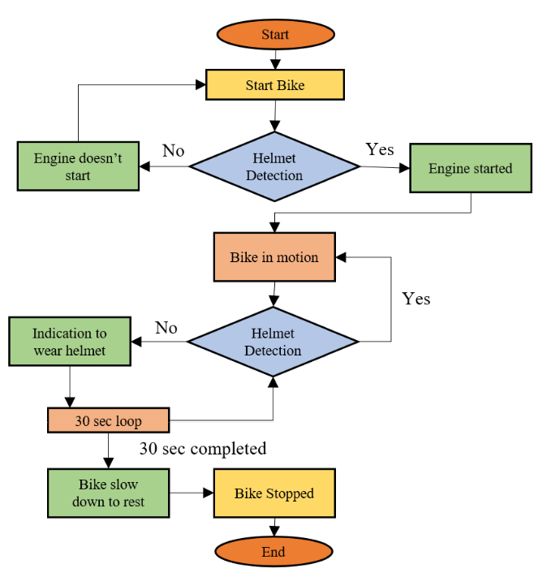
PROJECT FLOW
We'll use a Raspberry Pi camera placed on the front of the bike to check if the rider is wearing a helmet before starting the engine. To deal with riders who might take off their helmets while riding, the same camera will take pictures of the rider's head and helmet. A smart program called YOLO will analyze the live pictures to see if the rider has their helmet on. If the helmet is missing, the system will make beeping sounds, flash LEDs, and show a message on a screen to remind the rider to put it on within 30 seconds. If they do, the bike will keep going as usual. But if they don't, the system will safely stop the bike.

Slide 16
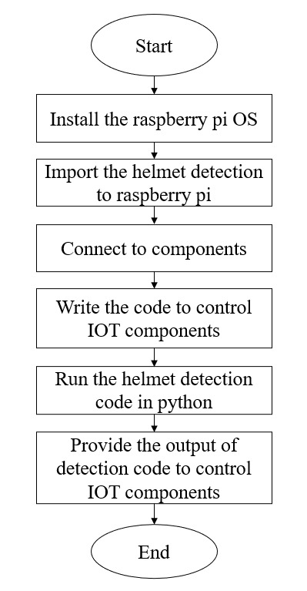
Project Flow of Implementation

Slide 17
TECHNOLOGY USED
Modules / APIs / Algorithms Used:
Open CV : Framework used for training the YOLO model
Ultralytics : Efficient tool for working in computer vision and ML that can help create accurate object detection models.
YOLO : You Only Look Once for detecting the object (Helmet).
Pandas : Library used in python for accessing csv/xml files.
NumPy : Library in python used for accessing images in array format
Raspberry Pi OS : Raspberry Pi Operating System for controlling the multiple operations.
Raspberry Pi Camera : Camera used for continuous imaging of rider.

Slide 18
MODULES
Our project aims to enforce helmet usage through a combination of deep learning techniques and IoT components. The project can be divided into two main modules:
1. Helmet Detection Module:
This module utilizes deep learning techniques, specifically YOLO (You Only Look Once) and CNN (Convolutional Neural Networks), to detect whether a rider is wearing a helmet.
YOLO:
YOLO (You Only Look Once) is a Convolutional Neural Network (CNN) used for efficient object detection in computer vision. Unlike traditional methods, YOLO treats object detection as a single regression problem, predicting bounding boxes and class probabilities for multiple objects simultaneously. It divides input images into grid cells, predicting bounding boxes and class probabilities within each cell.

Slide 19
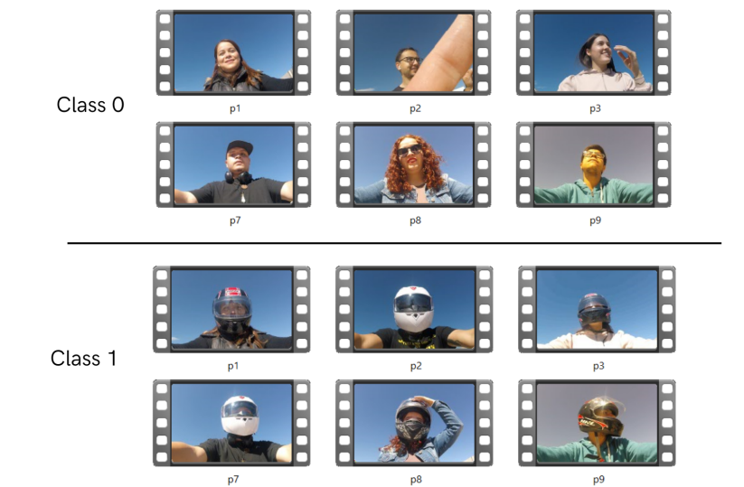
Model Creation
We gathered a dataset comprising images of riders with and without helmets to train our model to distinguish between helmeted and non-helmeted individuals. Employing the YOLO algorithm, we trained the model by iteratively adjusting its parameters and optimizing it for precise helmet detection. Rigorous testing validated the model's accuracy and reliability across diverse real-world scenarios, ensuring its ability to correctly identify helmets on unseen data. Subsequently, we implemented the detection code, enabling real-time detection of helmets from video streams or images captured by a camera, thus offering a comprehensive solution for enhancing safety in various environments.

Slide 20
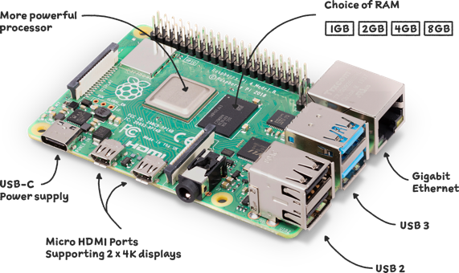
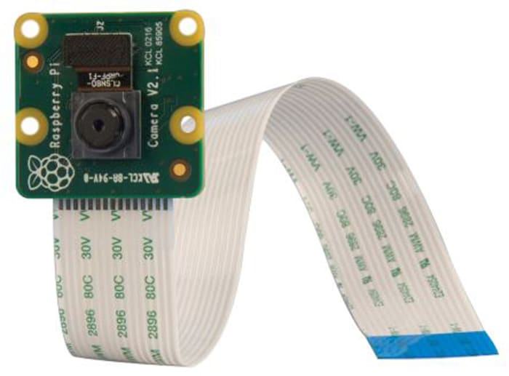
2. IOT Integration module:
Raspberry Pi 4 Model B: This serves as the central microcontroller unit responsible for processing data from the camera and controlling the bike's engine (represented by a DC motor). The Raspberry Pi provides the computational power necessary for running the detection algorithm and making decisions based on the results.
Raspberry Pi Camera: The Raspberry Pi is equipped with a Pi Camera module, which captures a live video feed of the rider. This feed is then processed by the detection algorithm to determine whether a helmet is present.
Raspberry Pi 4 Model B
Raspberry Pi Camera

Slide 21
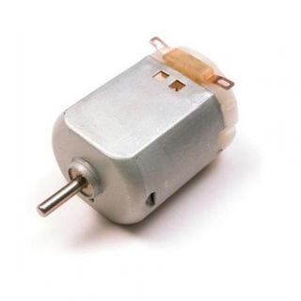
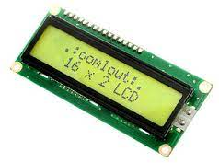
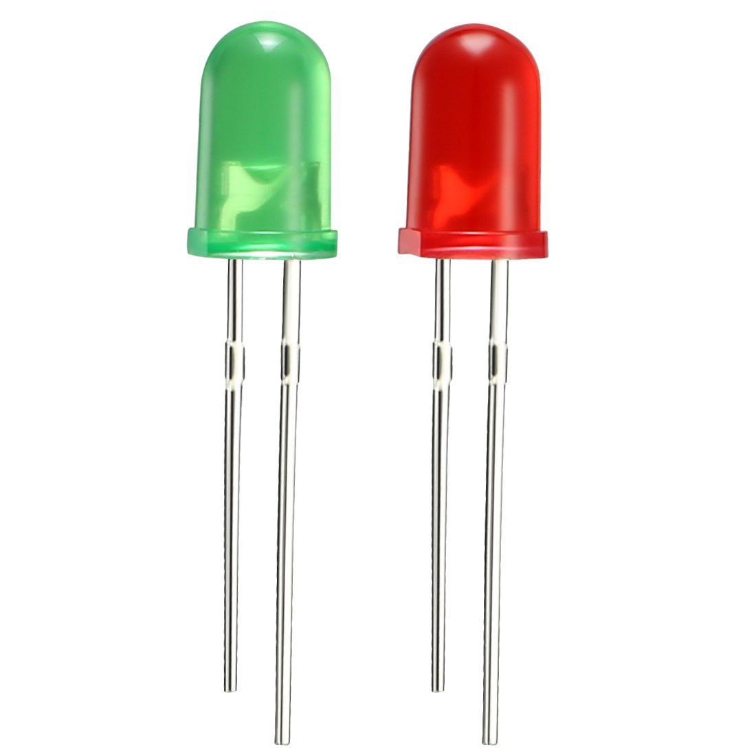
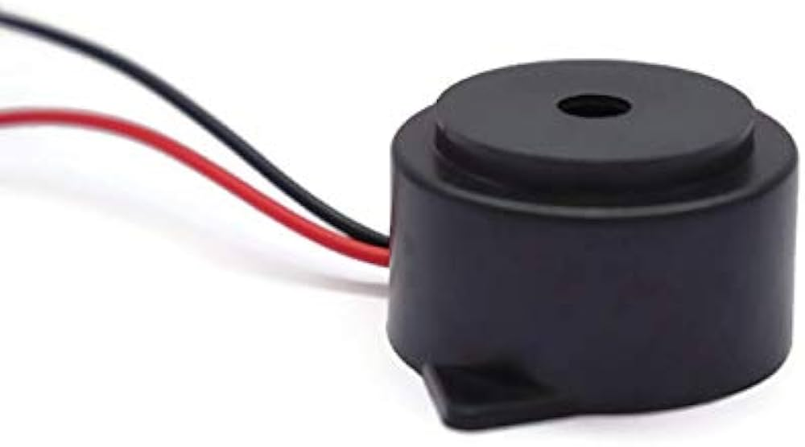
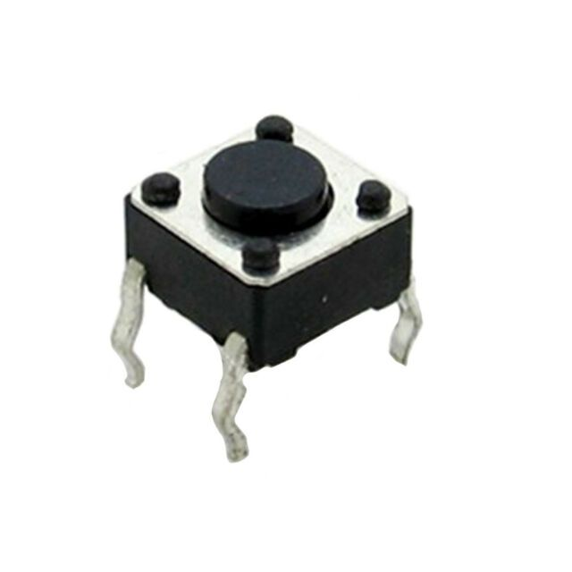
DC Motor: A Direct Current motor is one which converts direct current, electrical energy into mechanical energy which has a class of rotary electrical machines
Indication Components: To alert the rider when a helmet is not detected, we utilize LCD screens, LEDs, and buzzers. These components provide visual and auditory cues, ensuring immediate awareness of the safety violation. An external power supply is also employed to power these indication devices.
DC Motor
LCD Screen 16x2
LEDs
Buzzer
Push Button

Slide 22
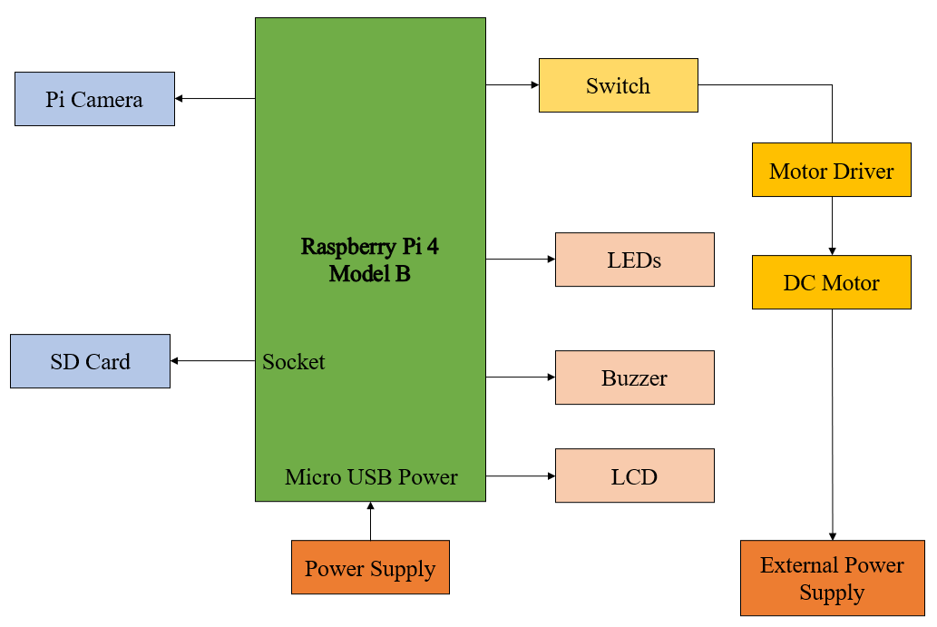
DETAILED DESIGN
This is the detailed design of our project. It includes all the IOT components and the detection code.

Slide 23
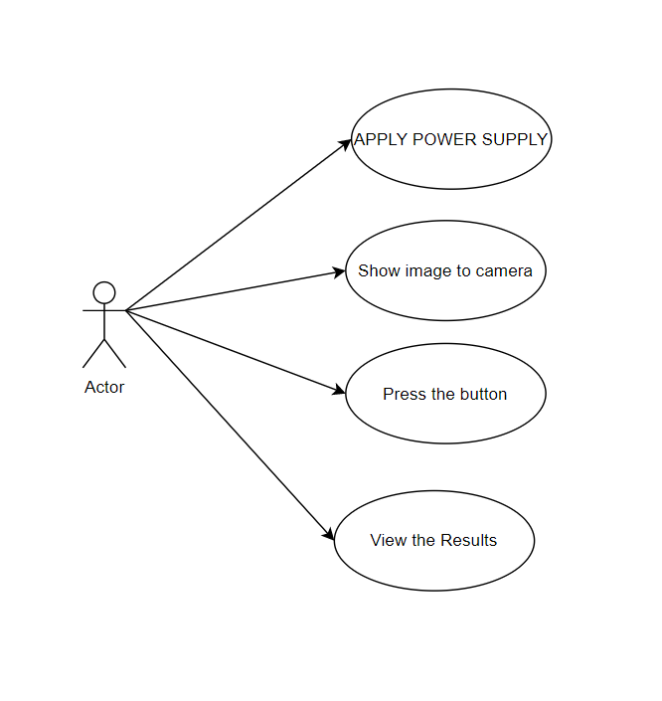
UML DIAGRAMS
USE CASE DIAGRAM:
The following shown figure is the Use-case diagram of our proposed project.
It describes what the system does and how the system operates internally.

Slide 24
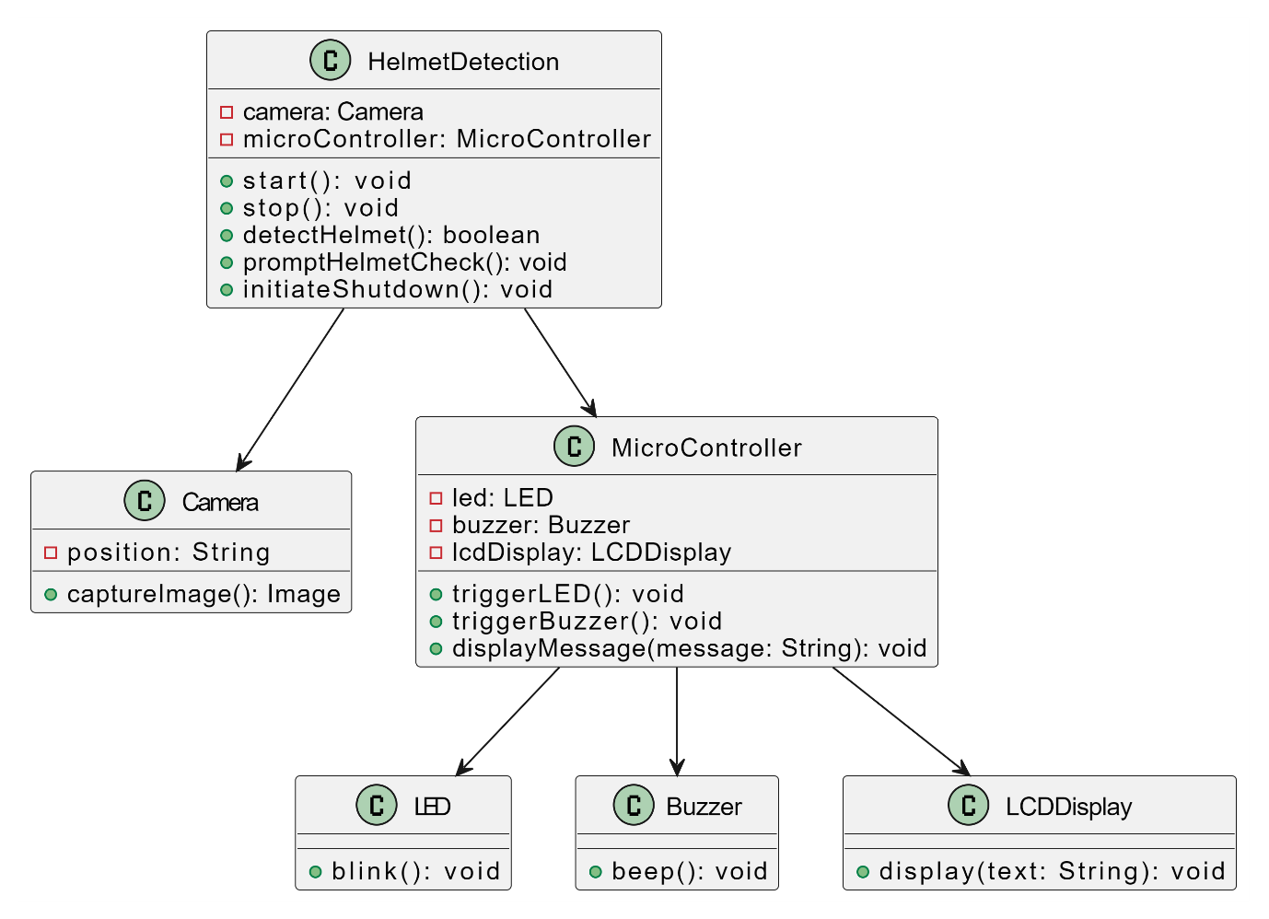
UML DIAGRAMS
2. CLASS DIAGRAM:
The following shown figure is the Class diagram of our proposed project.
It is used to model the objects that make up the system, to display the relationships between the objects and to describe what those objects do and the services that they provide.

Slide 25
UML DIAGRAMS
3. SEQUENCE DIAGRAM:
Sequence diagrams visualize interactions between objects/components, showing message flow over time.
Objects are represented by vertical lifelines, with arrows indicating message passing.
They aid in understanding system dynamics, message flows, and operation sequences.
In our system, user images are sent to the detection model via the camera, and outputs control hardware components for two-wheeler automation.

Slide 26
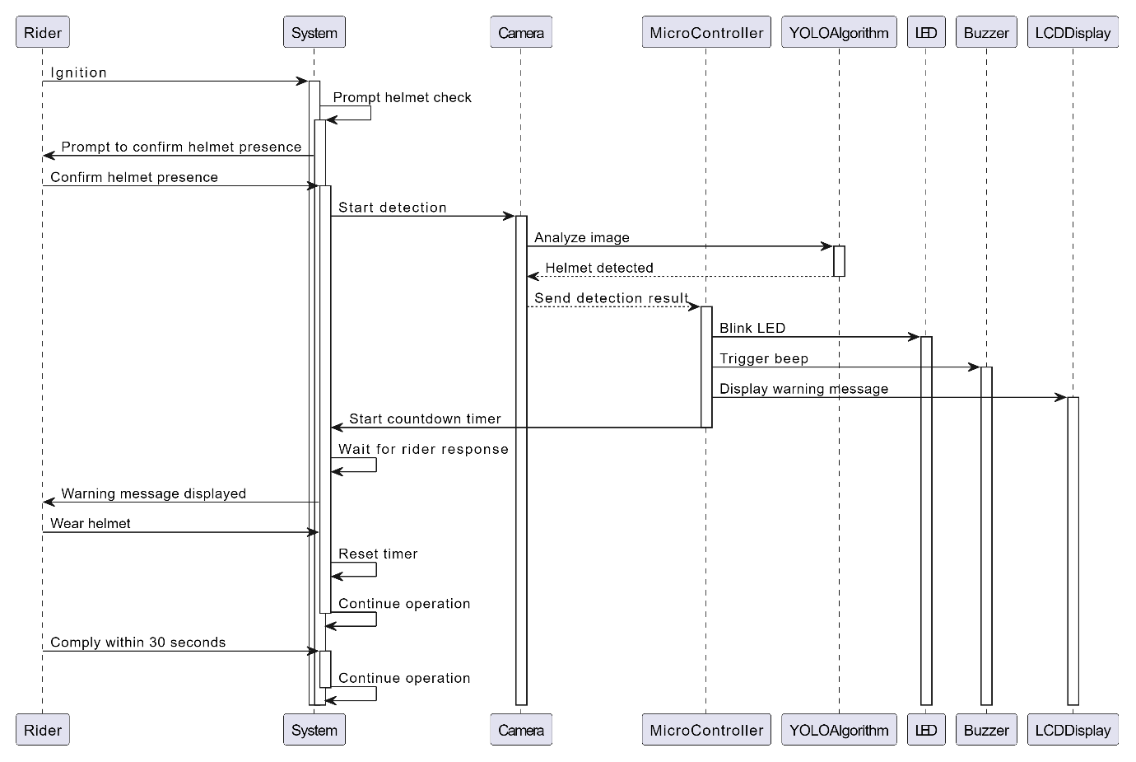
UML DIAGRAMS
3. SEQUENCE DIAGRAM:

Slide 27
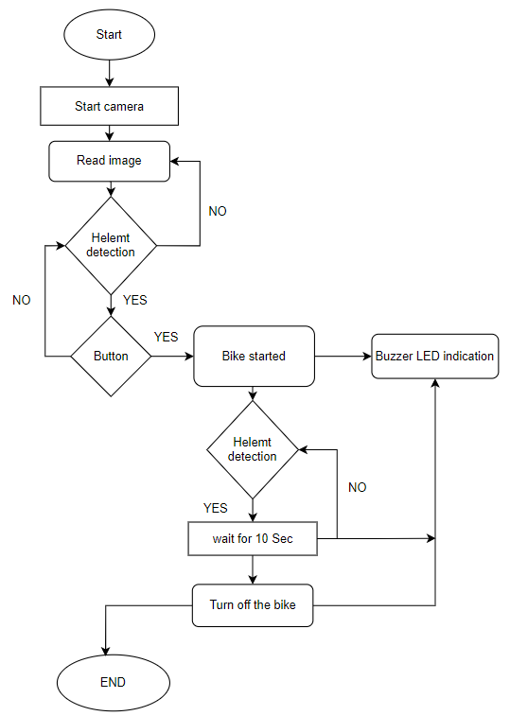
UML DIAGRAMS
4. FLOW DIAGRAM:
The following diagram is the flow diagram of Helmet detection and bike controlling feature.
The flow diagram provides an understanding of total operation of the system, serves as a basis for development of operational and contingency procedures, and pinpoints areas where changes in operational procedures could simplify the overall system operation.

Slide 28
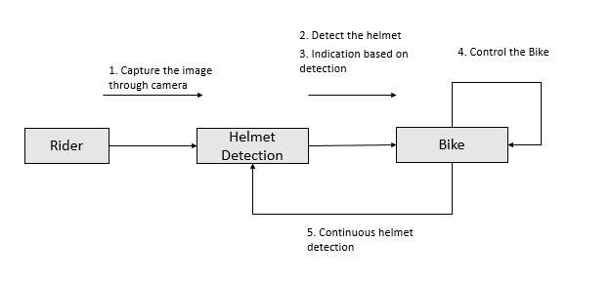
UML DIAGRAMS
5. COLLABORATION DIAGRAM:
A collaboration diagram depicts interactions between system objects to achieve tasks.
Objects are represented as rectangles, connected by lines showing message flow.
It clarifies how objects collaborate to accomplish specific objectives.
In the Smart Helmet Enforcement System, collaboration among components ensures effective helmet enforcement.

Slide 29
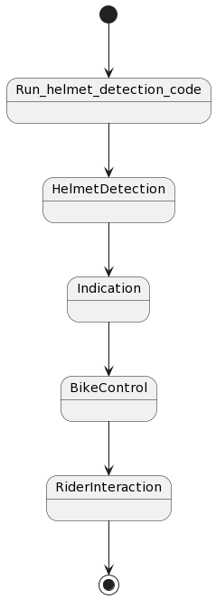
UML DIAGRAMS
6. STATE CHART DIAGRAM:
A state chart diagram in UML models object/system behavior across states and transitions.
It illustrates different states an object/system can be in and triggers for state transitions.
Useful for modeling complex behavior and system lifecycles.
Helps in understanding and designing dynamic systems effectively.

Slide 30
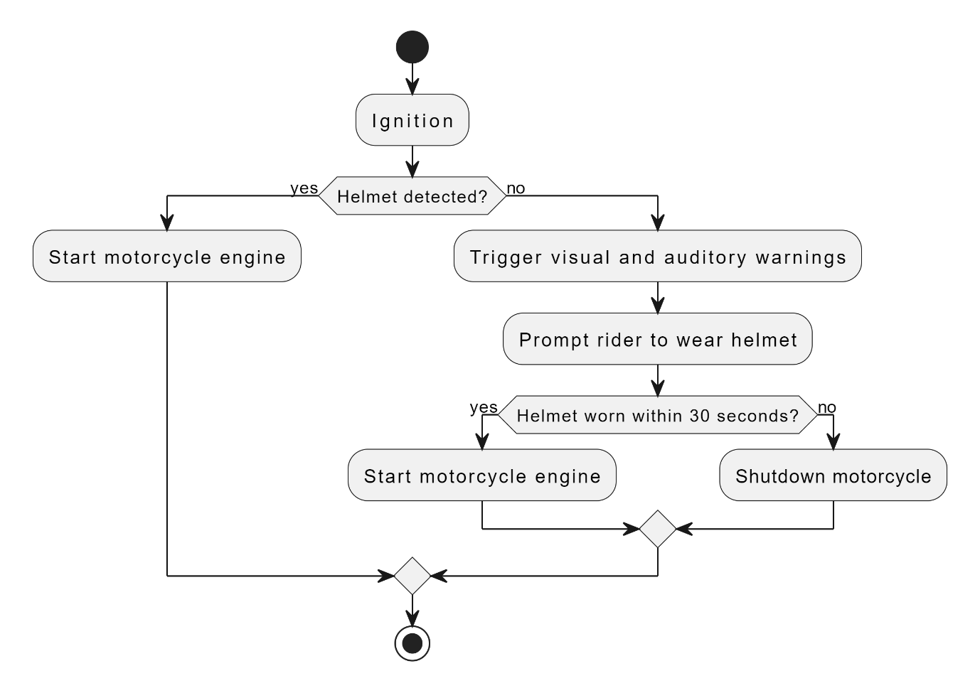
UML DIAGRAMS
7. ACTIVITY DIAGRAM:
Activity diagrams in UML illustrate activity flow within a system.
They represent tasks, decisions, and control flow using symbols like rectangles and diamonds.
Useful for modeling workflows and dynamic behavior of software systems.
They aid in understanding task sequences, capturing functional requirements, and identifying action relationships.

Slide 31
UML DIAGRAMS
8. COMPONENT DIAGRAM:
A component diagram in UML visualizes system components and their interactions.
Components represent modular parts like executable files or libraries.
Dependencies, interfaces, and relationships show how components collaborate.
They aid in designing architectures with interconnected modules for specific functionalities.

Slide 32
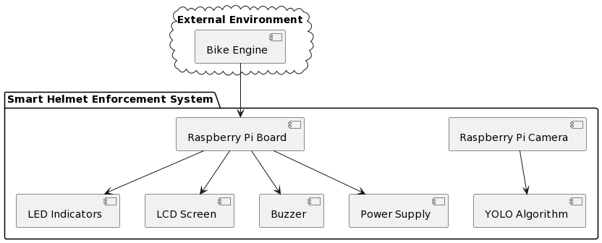
UML DIAGRAMS
8. COMPONENT DIAGRAM:

Slide 33
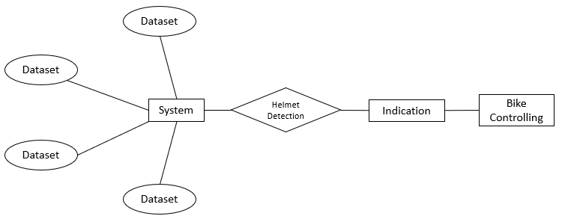
UML DIAGRAMS
9. ER DIAGRAM:
An Entity-Relationship Diagram (ERD) visually represents relationships between entities in a database.
Entities are depicted as rectangles, relationships as diamonds, and connections as lines.
ERDs serve as blueprints for designing database schemas.

Slide 34
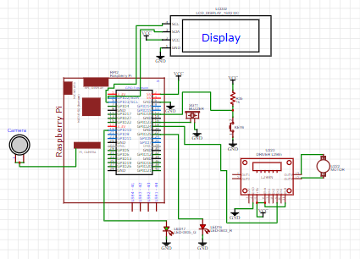
UML DIAGRAMS
10. CIRCUIT DIAGRAM:
The following diagram is the Circuit diagram of Helmet detection and bike controlling feature.
It shows about the all the circuit connections that are made in the project.
It focuses on the IOT components connections.

Slide 35
TESTCASES
Test Case Id | SHES_TC_01
Test Case Description | This test case evaluates the system's ability to accurately detect helmets under different lighting conditions.
Test Steps | Position the test subject wearing a helmet in an indoor environment with adequate lighting. Capture images using the Raspberry Pi camera. Repeat the process in an outdoor environment with varying lighting conditions (e.g., bright sunlight, shadowed areas). Trigger the helmet detection algorithm to analyze the captured images.
Expected Output | The system should accurately detect the presence of a helmet in both indoor and outdoor environments. Detection accuracy should remain consistent across different lighting conditions.
Actual Output | Successfully detecting the helmet various light conditions.
Preconditions | The Smart Helmet Enforcement System is properly set up and calibrated. Test subjects are available with helmets for testing purposes.
Postconditions | -
Result | Pass

Slide 36
TESTCASES
Test Case Id | SHES_TC_02
Test Case Description | This test case verifies the system's ability to detect helmets in real-time while the bike is in motion.
Test Steps | Mount the Raspberry Pi camera on the bike's front side, facing the rider. Start the bike and begin riding at various speeds. Continuously capture live video feed of the rider wearing or not wearing a helmet. Trigger the helmet detection algorithm to analyze the live video stream.
Expected Output | The system should accurately detect the presence of a helmet in both indoor and outdoor environments. Detection accuracy should remain consistent across different lighting conditions.
Actual Output | Detection is happening successfully while bike is in motion.
Preconditions | The Smart Helmet Enforcement System is securely installed on the bike. The Raspberry Pi camera and detection algorithm are functioning properly.
Postconditions | -
Result | Pass

Slide 37
TESTCASES
Test Case Id | SHES_TC_03
Test Case Description | This test case validates the system's ability to control the bike's engine based on helmet detection status.
Test Steps | Attempt to start the bike without wearing a helmet. Verify that the engine remains inactive and does not start. Wear a helmet and attempt to start the bike again. Confirm that the engine starts successfully. While the bike is in motion, remove the helmet and observe the system's response.
Expected Output | The engine should not start if the rider is not wearing a helmet. Engine startup should occur promptly upon detecting the presence of a helmet. If the helmet is removed while the bike is in motion, the system should initiate a controlled stop.
Actual Output | The engine is not starting if the rider is not wearing a helmet.
Preconditions | The Smart Helmet Enforcement System is integrated with the bike's engine control mechanism. Helmets are available for testing purposes.
Postconditions | -
Result | Pass

Slide 38
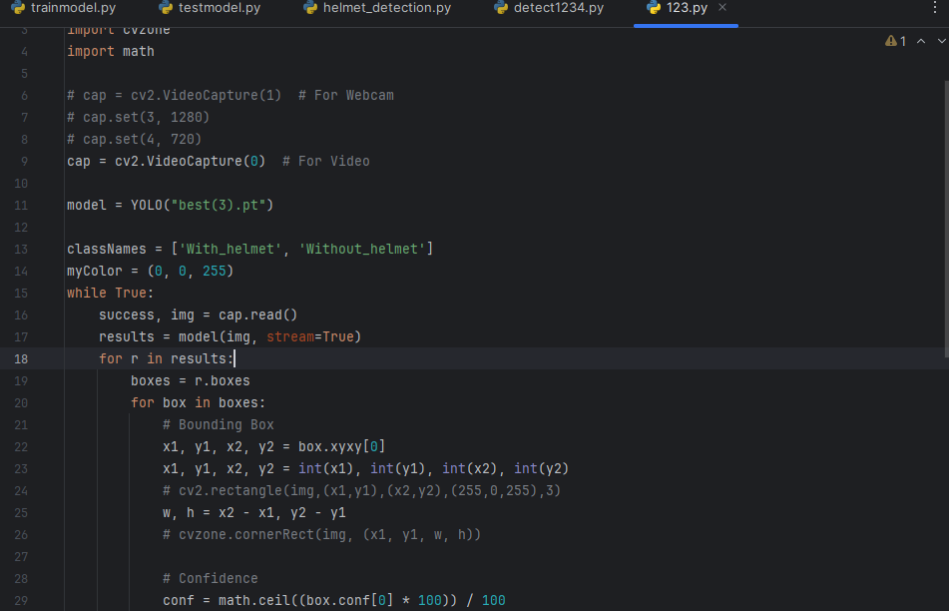
RESULTS
Helmet Detection code

Slide 39
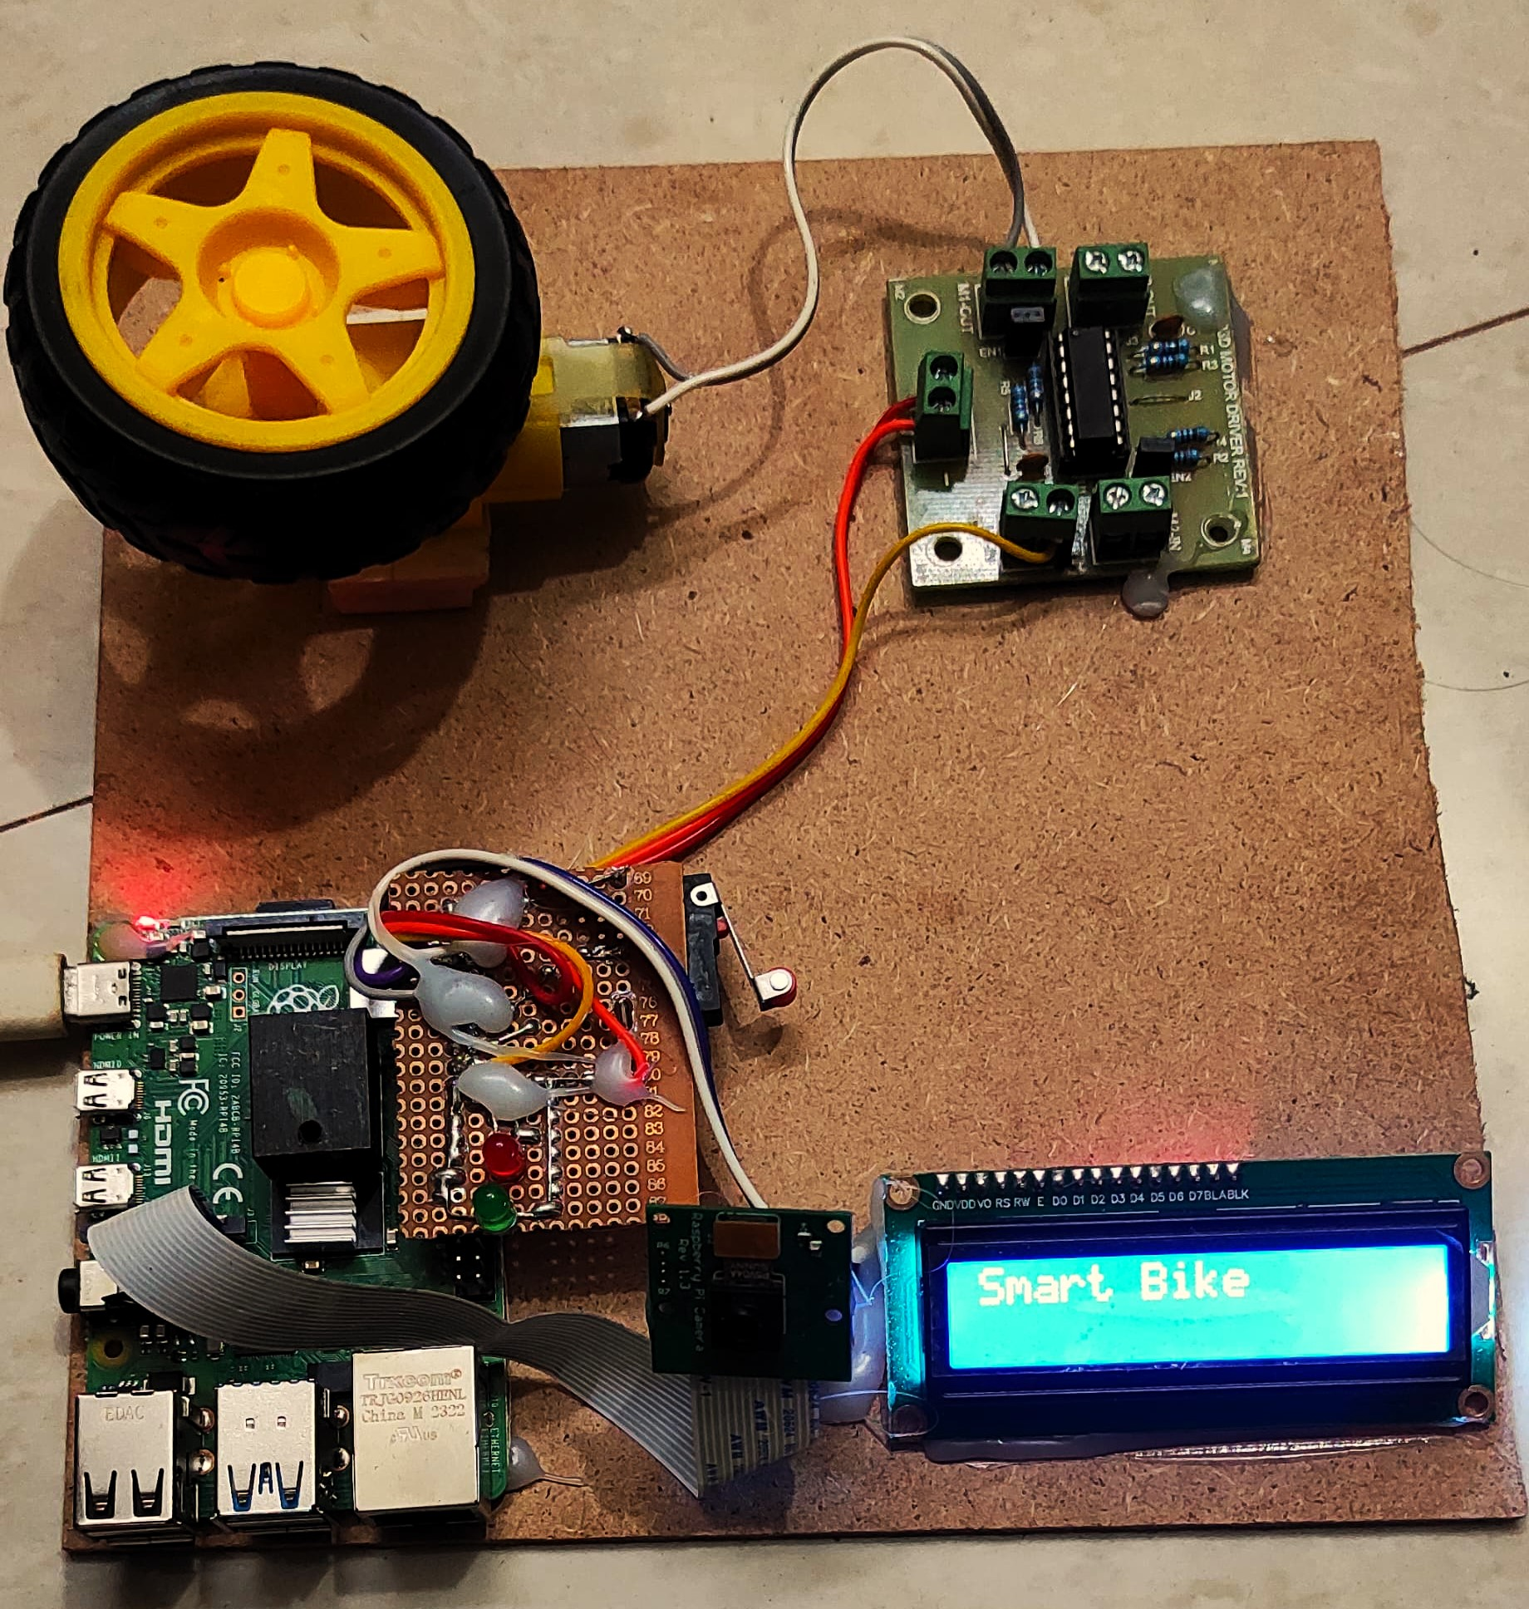
RESULTS
Final Project Prototype

Slide 40
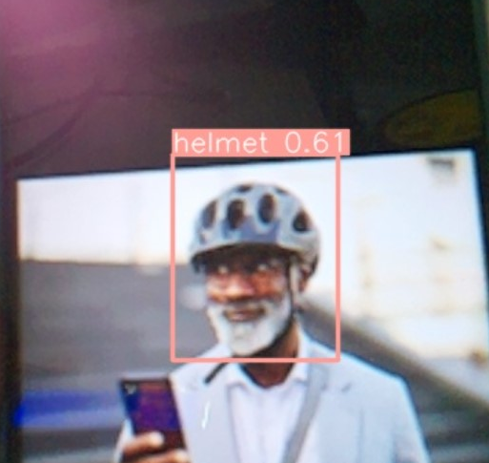
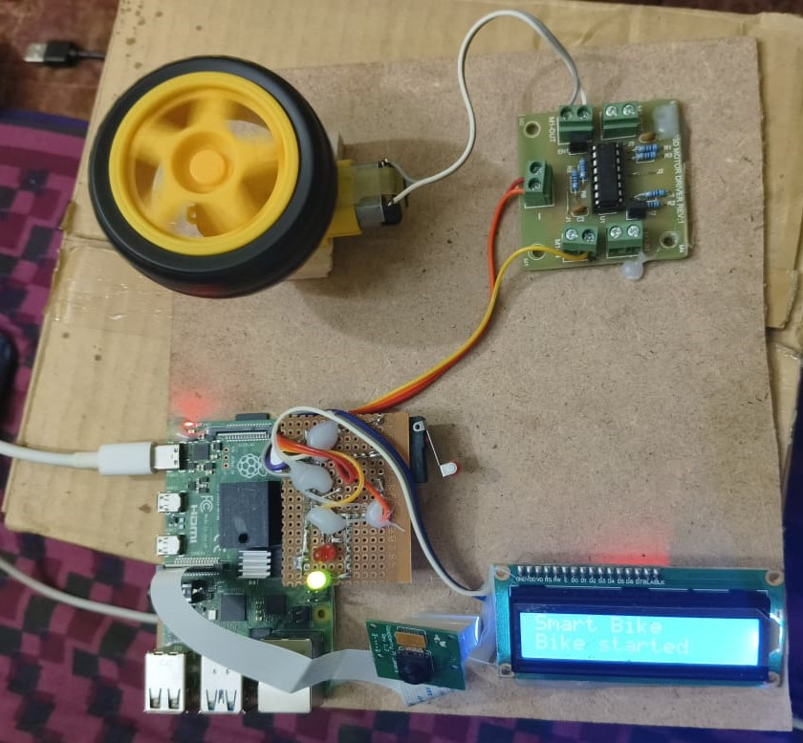
RESULTS
Helmet Detected
Bike wheel started Running

Slide 41
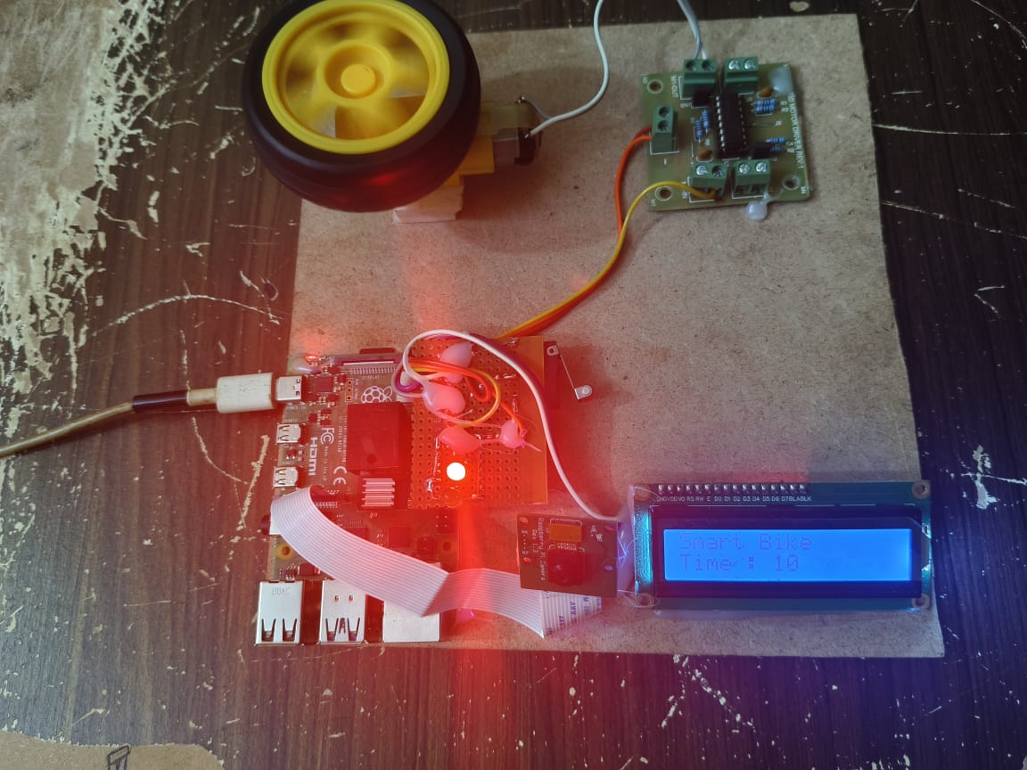
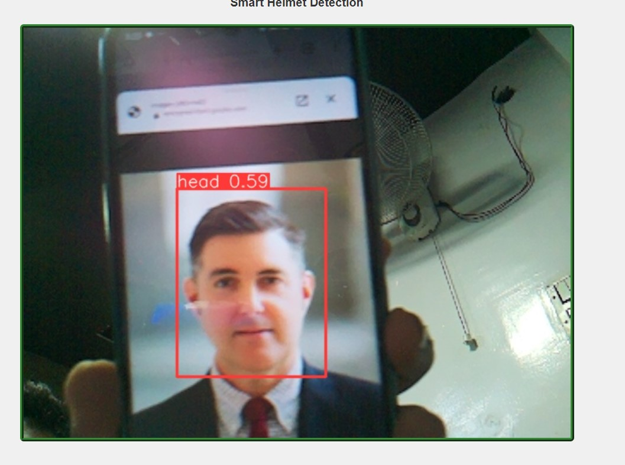
RESULTS
No helmet Detected
Indication and timer runs

Slide 42
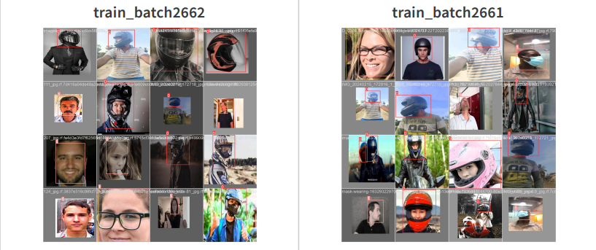
RESULTS
Model training and Validation

Slide 43
CONCLUSION
Our project centres around the utilization of Convolutional Neural Network (CNN) structured YOLO (You Only Look Once), a deep learning model meticulously trained with two image categories – with and without helmets.
This robust model ensures accurate helmet detection, forming the technological backbone of our Smart Helmet Enforcement System.
Integrated with Internet of Things (IoT) components, the YOLO's output seamlessly controls bike mechanisms, offering a comprehensive solution to minimize accidents caused by the absence of helmets among two-wheeler riders.
Going beyond detection, our project stands as a testament to responsible riding practices. By automating helmet enforcement, the system not only ensures prompt and accurate detection but also contributes to an overall safer riding experience.
The Smart Helmet Enforcement System aligns with our vision of promoting a culture where helmet usage becomes ingrained in every rider's habits, enhancing road safety and mitigating the risks associated with two-wheeler accidents.

Slide 44
FUTURE SCOPE
Driver Drowsiness Detection:
Integrate advanced sensors and algorithms for analyzing driver behavior.
Provide timely alerts to prevent potential accidents caused by driver drowsiness.
Alcohol Detection:
Extend the system to incorporate sensors for detecting alcohol levels.
Proactively discourage riding under the influence, enhancing overall road safety.
Night Vision Camera Enhancement:
Improve camera detection capabilities with the integration of night vision technology.
Ensure reliable helmet detection in low-light conditions, optimizing system effectiveness during nighttime riding scenarios.

Slide 45
TABLE FOR STUDENT CONTRIBUTION
TASKS | 20A91A0552 | 20A91A0544 | 20A91A0526 | 20A91A0559
Literature Survey
Problem Formulation
Requirements gathering
Resource Estimation
Documentation
PPT Preparation

Slide 46
REFERENCES
[1] Soltanikazemi, Elham, Armstrong Aboah, Elizabeth Arthur, and Bijaya Kumar Hatuwal. "Fine-Tuning YOLOv5 with Genetic Algorithm For Helmet Violation Detection." International Journal of Computer Vision (2024): 10(5), 100-115.
[2] Devi Lakshmi, G. S., Fathima, S. A., & Snehaa Sree, J. V. (2023). Smart Engine Control System Linked to Helmet Detection Using YOLOv8. International Research Journal of Modernization in Engineering Technology and Science, 5(5), IRJMETS39163.
[3] Srusti, C., Deo, V., & Jaiswal, R. C. (2023). Helmet Detection Using Machine Learning. Journal of Emerging Technologies and Innovative Research, 9(10), JETIR2210312.
[4] Mathew, A., Raj, A., Devakanth, S., Vyshnav, B. L., & Anselam, A. S. (2023). Real Time Road Surveillance and Vehicle Detection using Deep Learning. International Journal of Computer Vision (IJCV), 15(3), 245-259.

Slide 47
REFERENCES
[5] Mathew, A., Raj, A., Devakanth, S., Vyshnav, B. L., & Anselam, A. S. (2022). "Helmet Detection in Vehicles." Technical Report. Retrieved from https://www.researchgate.net/publication/369185002
[6] Siva Lalith, K. S. P. V., Sudhamshu, M., Abhishek, G. K., Swamy, T. R., Jayaprakasan, V., & Acharya, G. P. (2022). Intelligent Helmet Detection Using OpenCV and Machine Learning. International Research Journal of Engineering and Technology, 9(04), 3838-3842.
[7] Jamtsho, Y., Riyamongkol, P., & Waranusast, R. (2021). Real-time license plate detection for non-helmeted motorcyclists using YOLO. ICT Express, 7, 104-109. DOI: https://doi.org/10.1016/j.icte.2020.07.008
[8] Das, S., Santra, S., & Sinha, S. (2021). "Smart Helmet with Quick Ambulance Response System." International Journal of Engineering Research & Technology, Volume(Issue)

Slide 48
REFERENCES
[9] Saranya, S., Malveka, R., Ragavi, S., Gokul Raj, N., & Narayanan, P. (2020). Automatic Detection of Bike-riders without Helmet using Surveillance Videos in Real-time. International Journal of Engineering Development and Research, 8(1), 605-609.
[10] Alim, M.E., Ahmad, S., Dorabati, M.N., & Hassoun, I. (2020). Design & Implementation of IoT Based Smart Helmet for Road Accident Detection.

Slide 49
WEB LINKS
https://github.com/EdjeElectronics/TensorFlow-Object-Detection-API-Tutorial-Train-Multiple-Objects-Windows-10
https://www.digikey.com/api/videos/videoplayer/smallplayer/6197617716001
https://www.hindawi.com/journals/mpe/2022/8246776/#literature-review
https://circuitdigest.com/microcontroller-projects/driver-drowsiness-detector-using-raspberry-pi-and-opencv
https://www.youtube.com/watch?v=0hrF8Wq8SSQ
https://doi.org/10.1016/j.icte.2020.07.008
https://www.researchgate.net/publication/369185002

Slide 50



